Slide 1
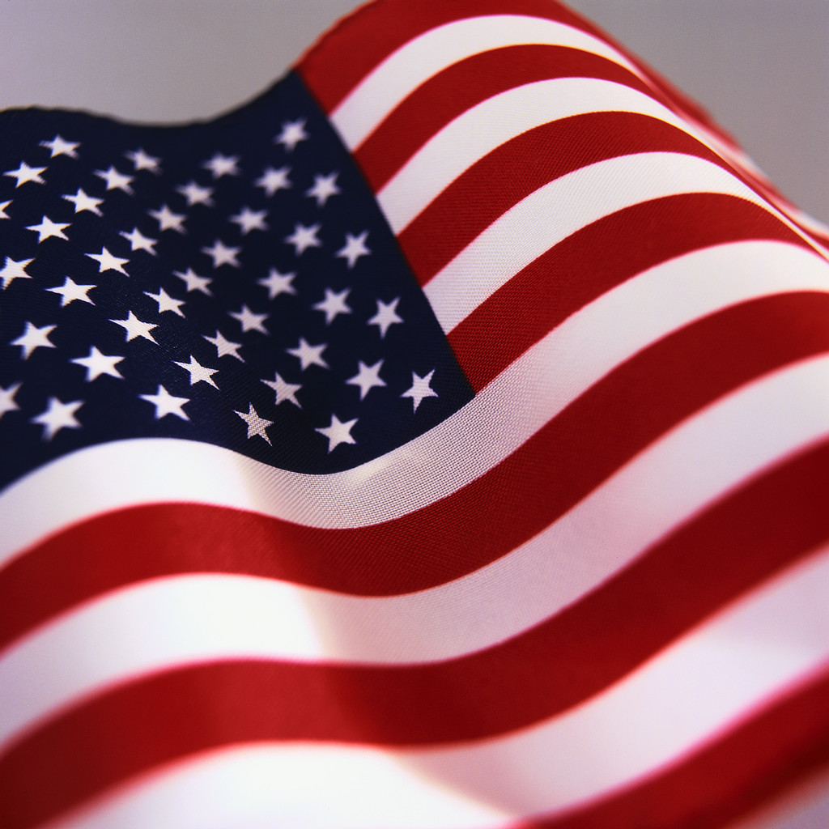
The Star-Spangled Banner:
National Anthem of the United States of America
Lyrics by Francis Scott Key

Slide 2

O say can you see by the dawn’s early light,

Slide 3
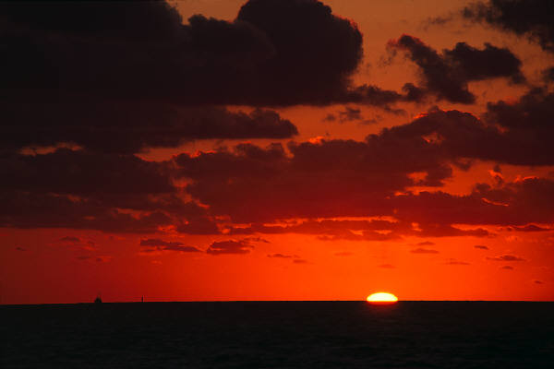
What so proudly we hailed at the twilight’s last gleaming,

Slide 4
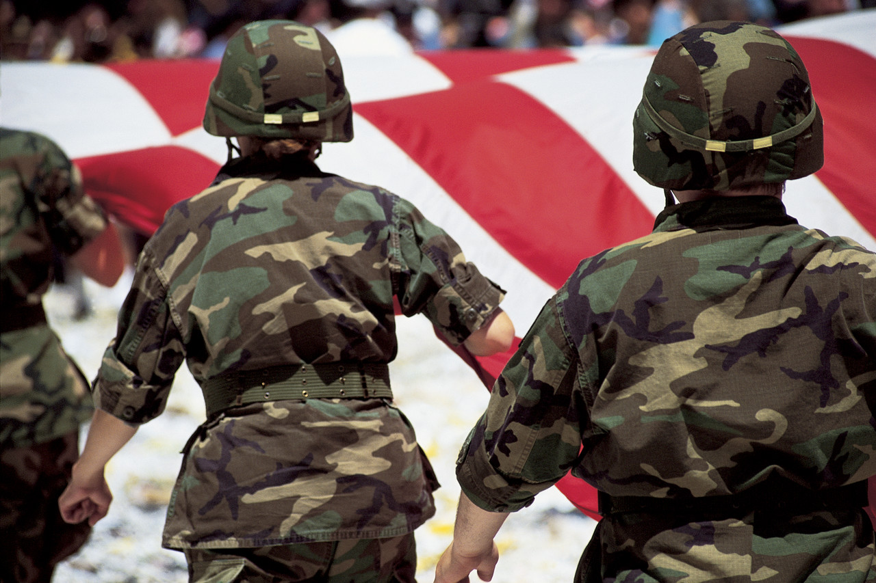
Whose broad stripes and bright stars through the perilous fight,

Slide 5
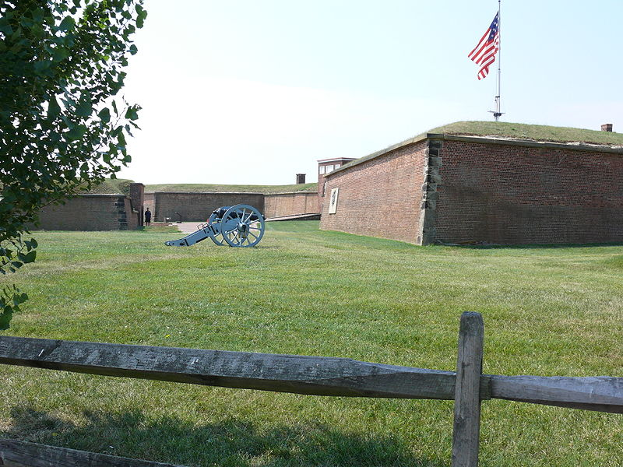
O’er the ramparts we watched, were so gallantly streaming?

Slide 6
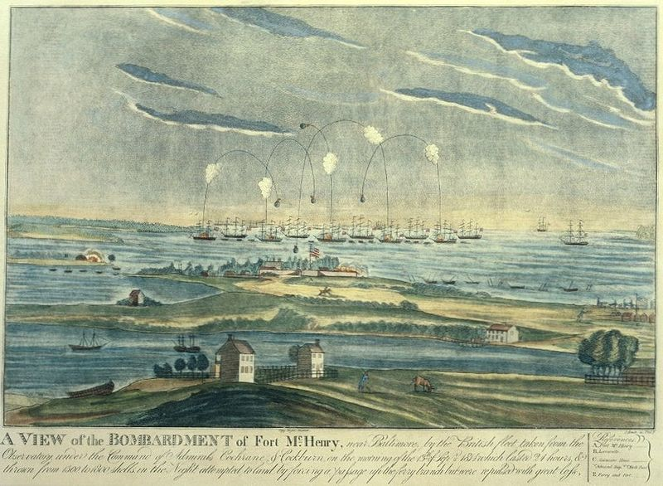
And the rockets’ red glare, the bombs bursting in air,

Slide 7
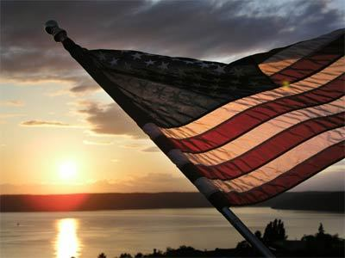
Gave proof through the night that our flag was still there;

Slide 8
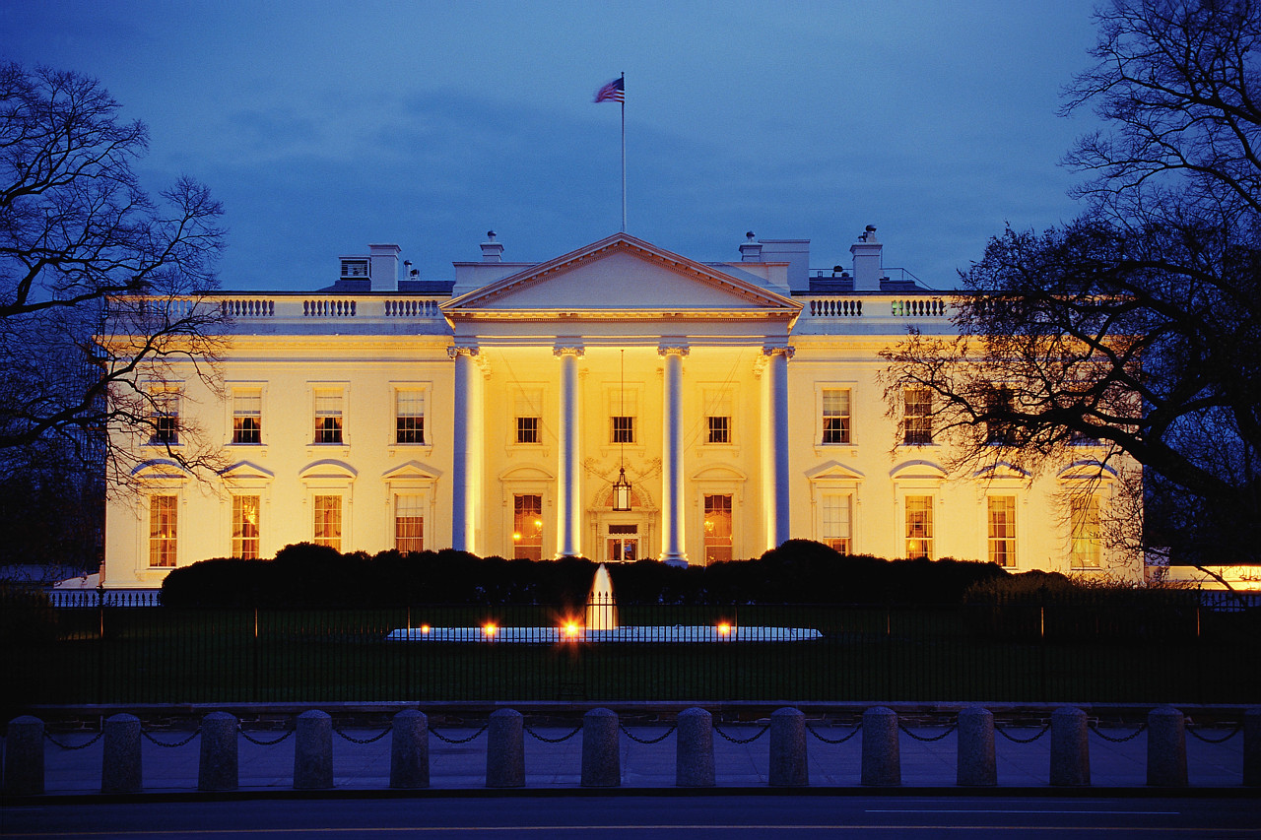
O say, does that star-spangled banner yet wave,

Slide 9
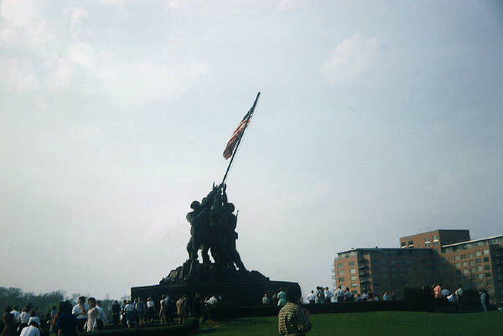
O’er the land of the free and the home of the brave?

Slide 10
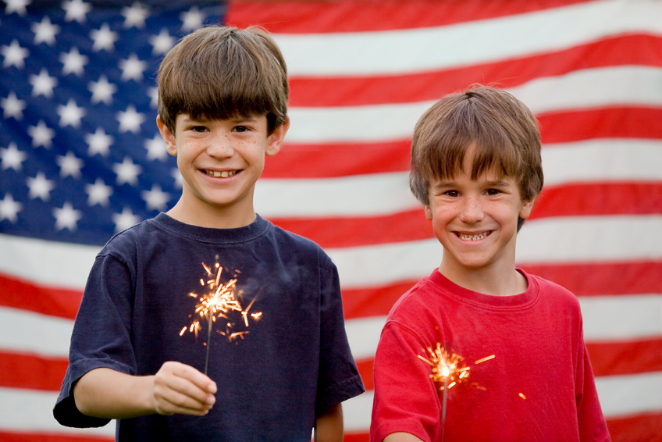
Facts about our National Anthem:

Slide 11
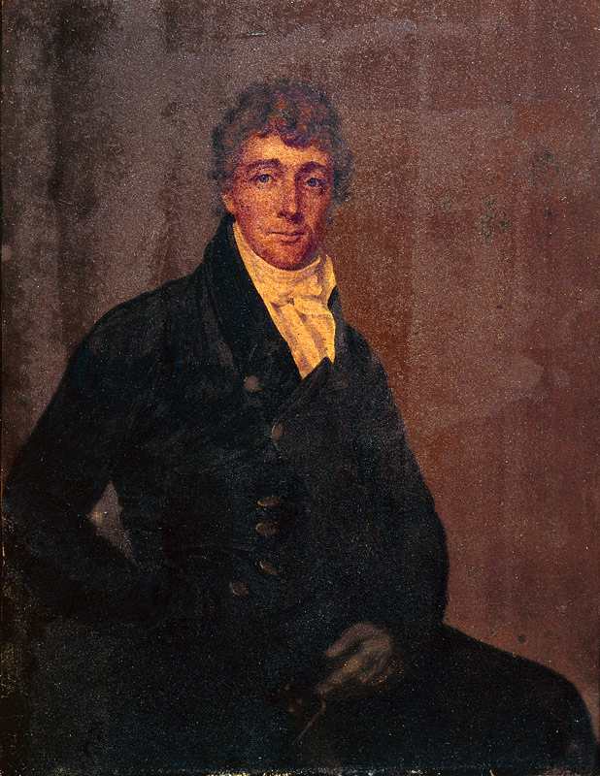
The lyrics were written in 1814 by American poet Francis Scott Key. He witnessed the bombardment of Fort McHenry by British ships during the War of 1812.

Slide 12
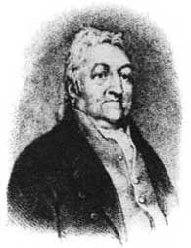
The tune was originally written by British composer John Stafford Smith. He called it “The Anacreontic Song.”

Slide 13
“The Star-Spangled Banner” was a very popular American song throughout the 1800s, but it did not become the official national anthem until 1931, when President Herbert Hoover signed a congressional resolution.

Slide 14
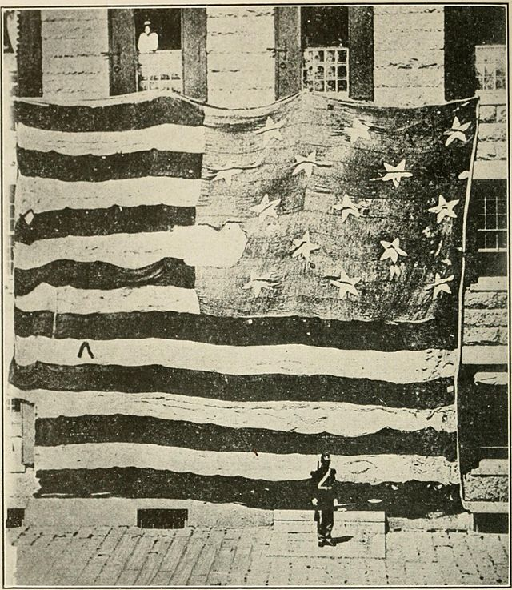
This is the actual flag that flew over Fort McHenry during the 1814 bombardment. The flag was donated to the Smithsonian in 1912.

Slide 15
Thank you for downloading this file! I value your feedback.
Please leave comments at http://www.teacherspayteachers.com/Store/Jaylene-Scott and earn TpT credit!
Visit my blog at www.jayleneteachesmusic.blogspot.com for ideas on how to use this and other products
Credits:
All clip art and backgrounds from Microsoft Office Suite unless noted otherwise.
John Stafford Smith photo:
"John Stafford Smith". Via Wikipedia - http://en.wikipedia.org/wiki/File:John_Stafford_Smith.jpg#mediaviewer/File:John_Stafford_Smith.jpg
Francis Scott Key photo:
"Francis Scott Key by Joseph Wood c1825" by attributed to Joseph Wood (1778-1830) - [1]. Licensed under Public domain via Wikimedia Commons - http://commons.wikimedia.org/wiki/File:Francis_Scott_Key_by_Joseph_Wood_c1825.jpg#mediaviewer/File:Francis_Scott_Key_by_Joseph_Wood_c1825.jpg
Photo of Fort McHenry flag:
"Fort McHenry flag" by George Henry Preble - National Star-Spangled Banner Centennial, Baltimore, Maryland, September 6 to 13, 1914 (1914).. Licensed under Public domain via Wikimedia Commons - http://commons.wikimedia.org/wiki/File:Fort_McHenry_flag.jpg#mediaviewer/File:Fort_McHenry_flag.jpg
Photos of Fort McHenry:
"Ft. Henry bombardement 1814" by Original uploader was Dr.frog at en.wikipedia - Transferred from en.wikipedia. Licensed under Public domain via Wikimedia Commons - http://commons.wikimedia.org/wiki/File:Ft._Henry_bombardement_1814.jpg#mediaviewer/File:Ft._Henry_bombardement_1814.jpg
"Fort McHenry2" by Ad Meskens - Own work. Licensed under Creative Commons Attribution-Share Alike 3.0 via Wikimedia Commons - http://commons.wikimedia.org/wiki/File:Fort_McHenry2.JPG#mediaviewer/File:Fort_McHenry2.JPG

