Slide 1
Who is the City of Bartlett Mayor? Meet A. Keith McDonald
2020

Slide 2
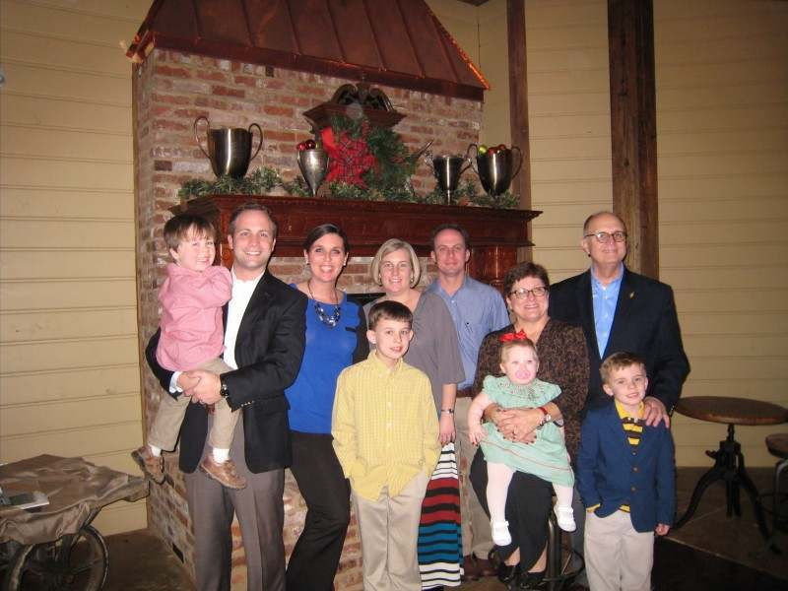
Mayor McDonald’s Family
Mayor McDonald has been married 49 years to his wife, Patricia. They have two sons Ryan and Brooks. Both of his sons are married and have children. Mayor McDonald has 4 grandchildren.

Slide 3
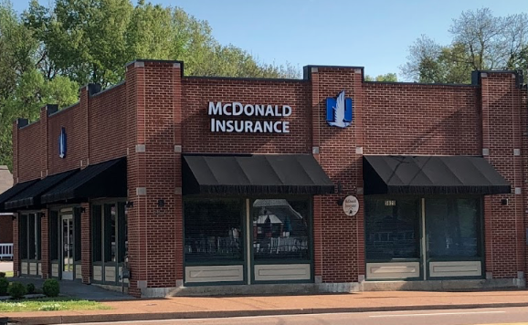
Mayor McDonald’s Previous Employment
Did you know Mayor McDonald once worked in retail business and radio broadcasting? For 32 years he was in the insurance business. He was the founder of McDonald Insurance and Financial Services. He retired from that position after 32 years.

Slide 4
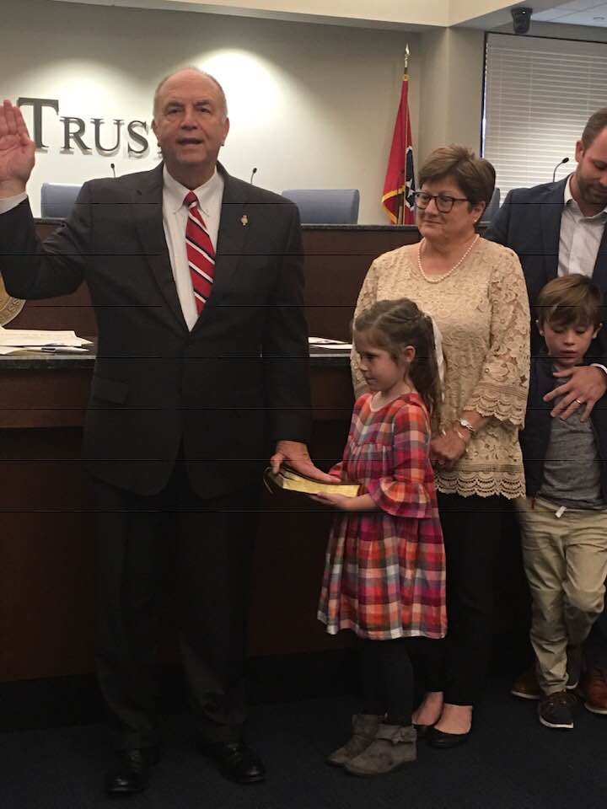
Mayor McDonald’s Civic Duties
Mayor McDonald has been very involved with civic responsibilities. He was once President of Bartlett Chamber of Commerce. He served as Past president of the West TN Mayor’s Association. He was elected Mayor of Bartlett in 2003.

Slide 5
Mayor McDonald’s Education
The mayor went to Clarksville High School in Clarksville, TN. He attended both Freed Hardeman College in Henderson, TN and Memphis State University (now University of Memphis) in Memphis, TN.

Slide 6
Can you find Clarksville, TN? Henderson, TN is near Lexington TN. Can you find it? Can you find Memphis?

Slide 7
What Does Mayor McDonald Do?
The Mayor handles all the business for the city of Bartlett. He works very hard! He works with the aldermen, the fire department and the police department and people like you. We are very glad he is our Mayor.

Slide 8
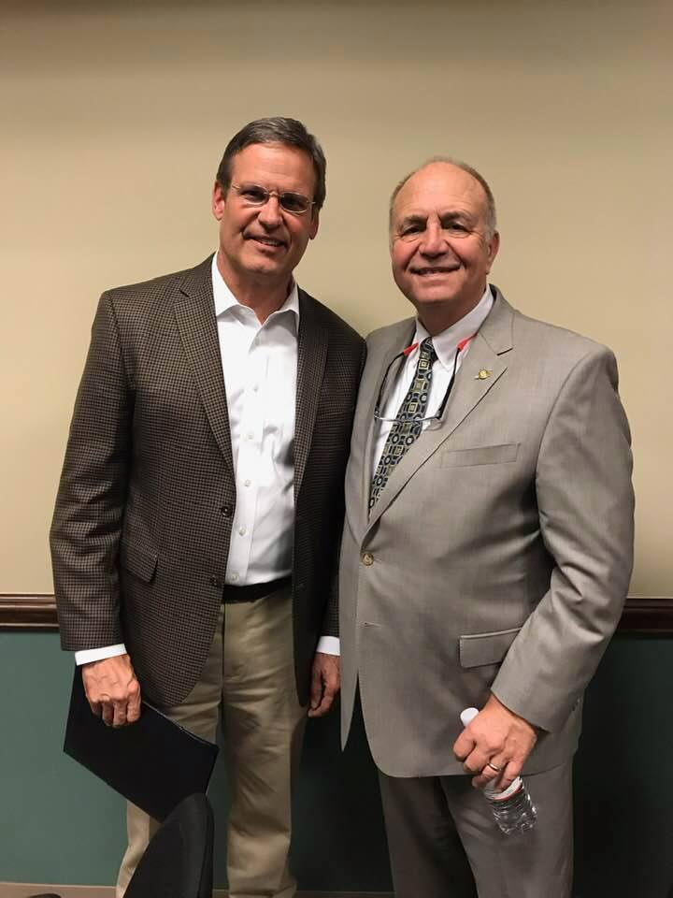
How Does the Mayor Represent Our City?
The Mayor represents our city at the TN government level and at the federal level.
He wants what is best for our city.
Here is a picture of Mayor
McDonald with TN Governor
Lee.

Slide 9
As citizens of Bartlett, we should be respectful of our Mayor. He is our friend and will help our city as best he can.

